Slide 1

Home solar power (Or how I came to have a $14/month electricity bill)
Paul Goodjohn & Chris Hettinger

Slide 2
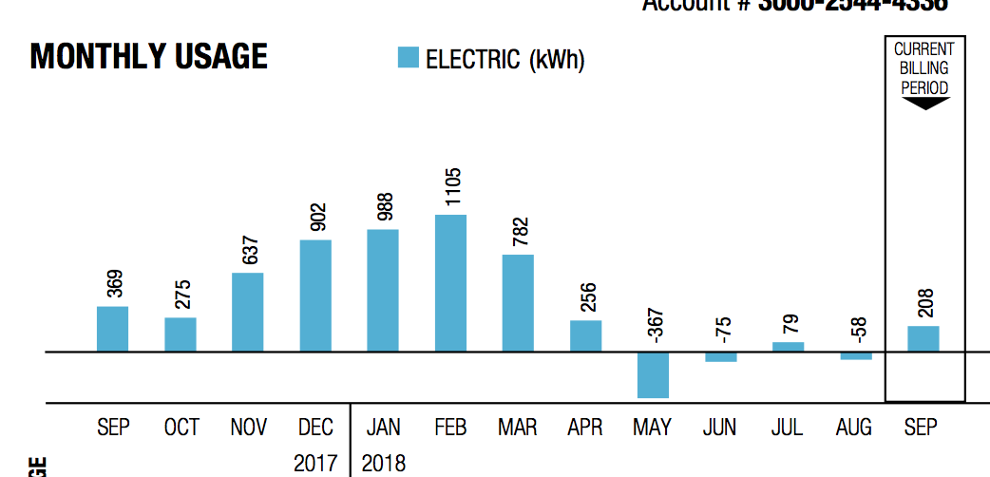
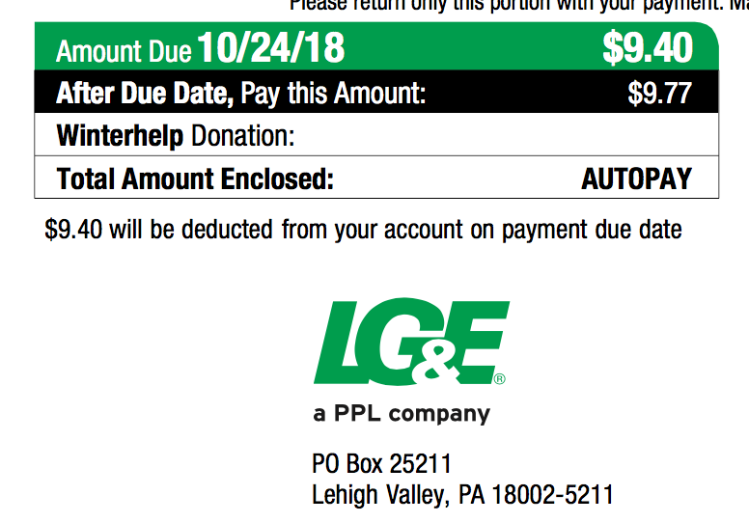

Slide 3
Before spending money on solar stuff…
Why add solar?
What’s it like to live with?
Terminology
What does it cost?
Free money!
Payback/Return on investment
Retirement planning
Solar hot water
Off grid or grid tied
Inverter type
What would I need?
What’s involved in putting the system together?
Suppliers
Useful stuff/toys
Questions

Slide 4
Before spending money on solar stuff…
Energy audit ($100) In my case, this led me to:
Roof insulation (12+ inches extra fiberglass insulation) ($1200)
LED lights ($200)
Seal round windows and doors ($30)
Seal the air leaks from outlet boxes (same caulk for windows)
Seal the AC ducting and insulate the duct in the roof ($100)
Energy star roof shingles

Slide 5
Why add solar?
Low risk and high return investment: cash saved on electricity bill is after-tax lower bills are a big resale benefit
Good as part of retirement planning
Hedge against higher electricity prices in the future
Good for the planet (But so is walking places, riding a bike and going vegetarian)
It’s deeply cool making your own power
It is a fun DIY project
My friends and neighbors will be impressed/horrified

Slide 6

What’s it like to live with?

Slide 7
No, you muppet, what’s it like to live with really?
With my system (9kw on the roof of my house, microinverters, net metering):
No maintenance (well, maybe hosing off the panels once in a while)
House is warmer in the winter, cooler in summer
Electricity bill is a touch more complex to read but a LOT smaller
Er, that’s it. Plug stuff in, it works.

Slide 8
Terminology
Inverter – a chunk of electronics that turns the direct current (DC) power from the panel(s) into alternating current (AC)
Kw – kilo-watt, a measure of power. A hairdryer or a drip coffee maker use about 1 kw, the dryer uses about 3 kw. A 3’x5’ solar panel makes about ¼ kw in really bright sunlight.
Kwh – kilo watt hour, or a load of 1 kw for 1 hour. When you look at the electricity bill, this is what they are counting. Before I started my house used about 40 kwh per day (2400 sq ft ranch). LG&E currently charge around $0.12/kwh.

Slide 9
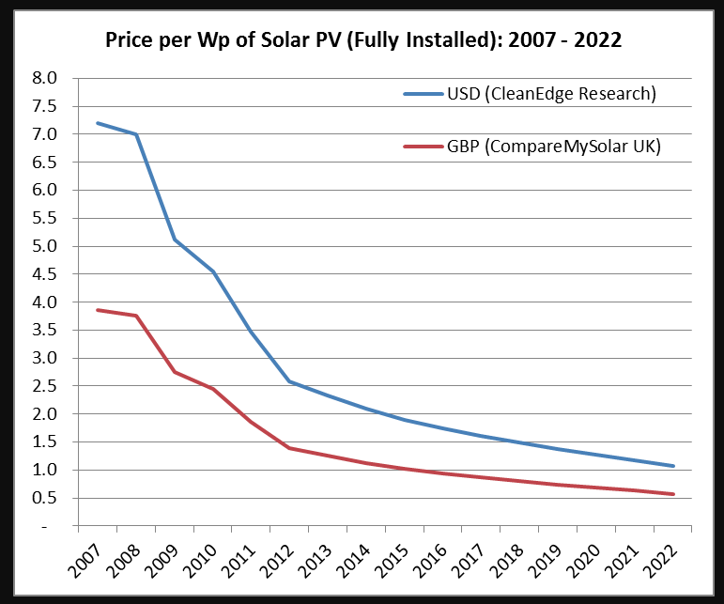
What does it cost?
Quote in 2013 for 3kw ground mount system was $18.5k.
Phase 1: 2013 DIY 5kw system (20 panels) - $11k (with $4.5k back) – the same system today would be $8k (with $2.4k back)
Phase 2: 2016 DIY 2kw from Craigslist - $2k
Neighbor bought 3kw DIY system from Craigslist for $3.4k
You can start with a single panel system for about $200…
Until the end of 2020 you get 26% back as a tax credit. 2021 is the last year, with 22% tax credit ☺
Solar hot water systems can be had for about $2k
Rough guide – DIY grid-tie is $1/w, professional grid-tie install is $3/w to $4/w and off grid with batteries is going to be around $6/w to $7/w.

Slide 10
Free Money!
First, the Federal government in 2022 will give you a 26% tax credit on all money you spend on solar (water heating and photovoltaic equipment).
That 26% also includes tools, wiring, nails, bolts, electrical and plumbing changes, electrician fees, engineering fees, permitting costs and so on. It does NOT cover your labor if you install it yourself, nor does it cover replacing your roof.
In 2023 that drops to 22%.
Second if you run a business from your house and you live in a rural area (Oldham county for example counts) you can apply to “Rural Energy for America Program” for grants and loans of up to $20k .

Slide 11
Payback/return on investment
There is a LOT of rubbish talked about how long solar takes to pay for itself, and it is rubbish because it implicitly assumes the installed solar panels have zero value once you install them.
The correct way to price them is as an investment, where the install cost is the capital, and the saved money from bills is the (after tax) interest on that capital.
If you sell your house with solar installed, it is worth more than a house without it just based on lower bills (assuming you got it inspected. You did get it inspected, right?).

Slide 12
Retirement Planning
Any steps you take to reduce your future bills are useful as part of retirement planning.
Buying roof insulation, better windows, sealing behind outlets and solar energy can be thought of as techniques to buy yourself lower bills (and more disposable income) in the future.
With the Federal tax credit of 26% this year, the government is helping out here more than in any other retirement investment.
Energy improvements are unlinked to market prices, and indeed tend to be more valuable in times with high energy price volatility.

Slide 13
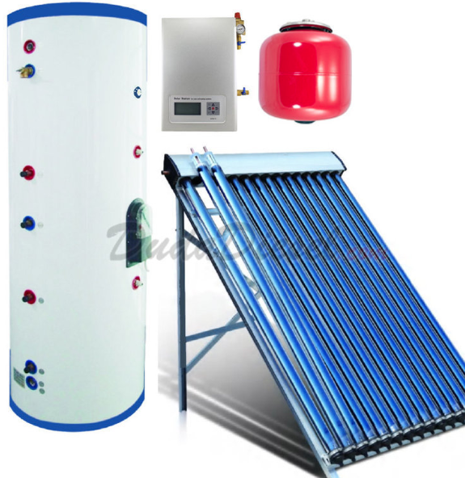
Solar hot water
Preheats water before it runs into your hot water tank
Solar collector on the roof, with a circulator pump and additional hot water tank
Water heating is 10%+ of house energy use
Best done as addition to current hot water system (preheat tank)
Some lifestyle changes …you want to run the washer, dishwasher etc. at night

Slide 14
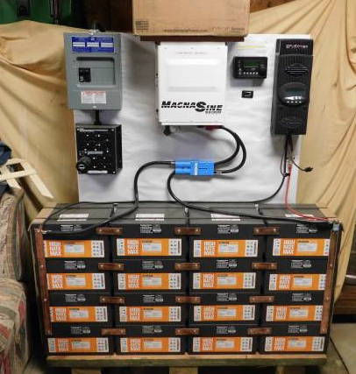
Off grid
Off grid – no electricity bill ☺
You provide all your own power – and don’t depend on the grid.
Significantly more expensive because it uses (lots of) batteries
Regular maintenance for batteries
Bad weather for prolonged periods means using backup generator
Great if the utility wants more than $50k to connect you to the grid
Almost impossible to find a professional installer that will do this for you.
*This is badly wired – don’t do this!

Slide 15
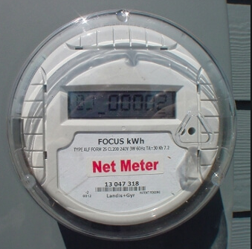
Grid tied
Grid tied – your house is still connected to the grid
You still get a bill ☹
If there’s snow on the panels for a week you still have power
You don’t have to replace all your power consumption with solar
Very low maintenance
This is what I have...

Slide 16
What would I need for grid tied PV?
You don’t need to replace all the power you use from the grid – start small.
Sun! So you need a clear view of the southern sky
Roof or space in the yard
Size of system is measured in kW – one panel is about 3’x5’ and makes about ¼ kW.
System comprises panels, inverters, wiring and a mounting system
If you needed 25kwh/day, we get about 5 hours of sunshine per day so you would need 25 / 5 or 5kw of solar panels, about 20 panels.

Slide 17
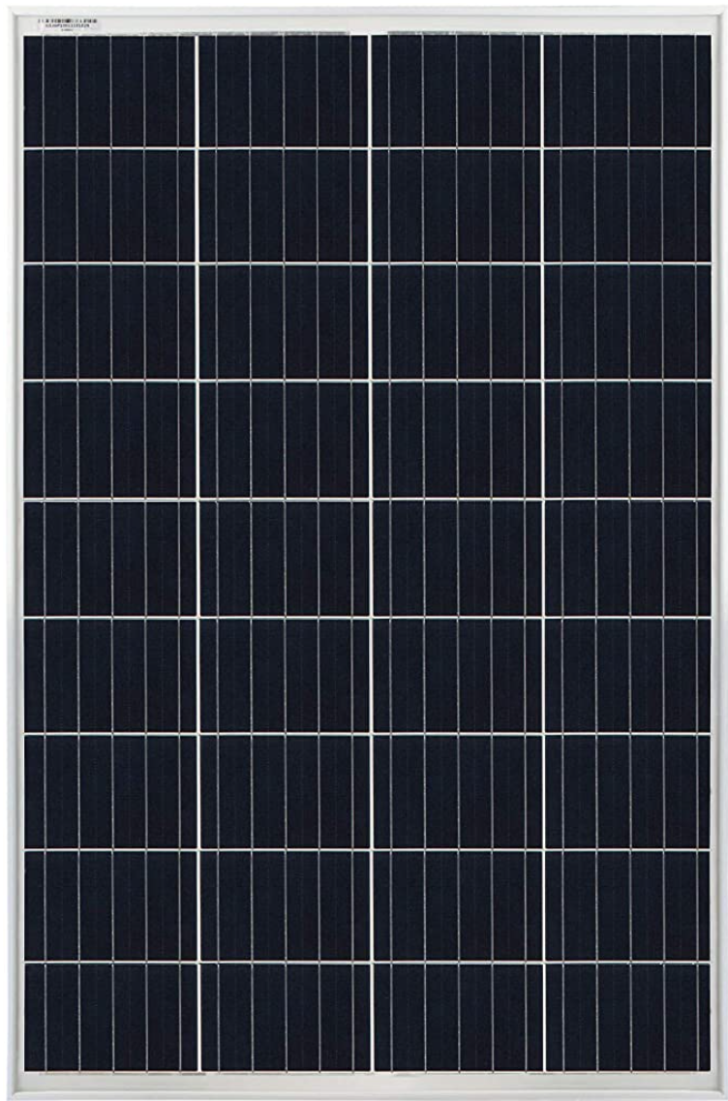
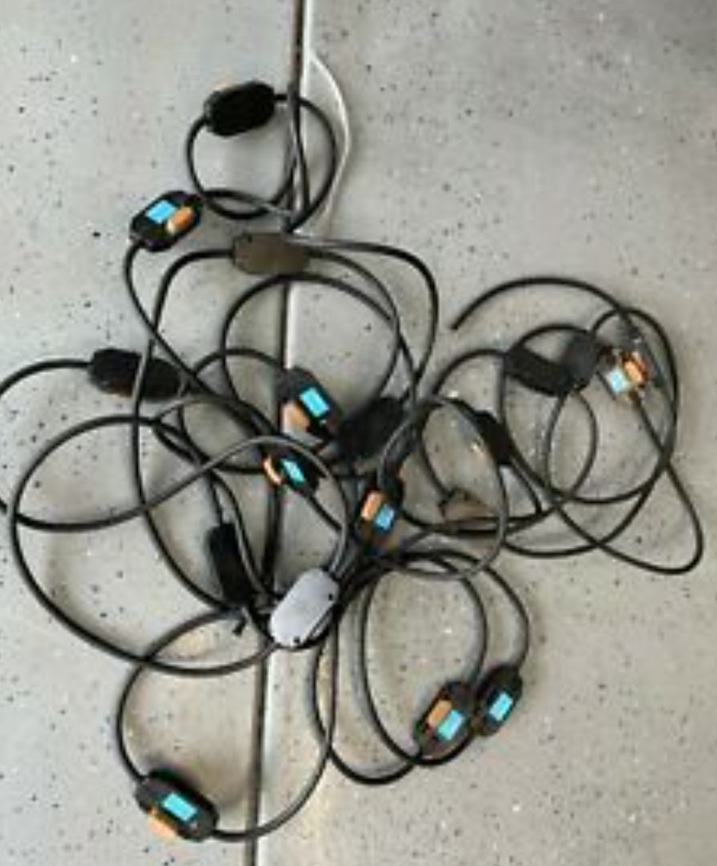
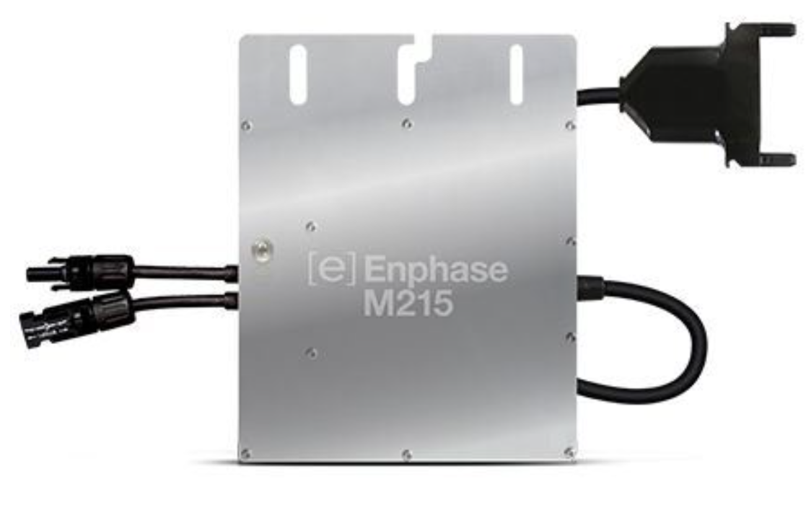

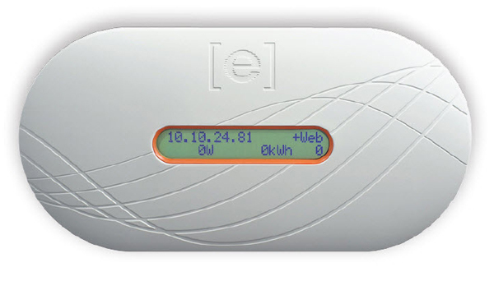
Enphase M Series Wiring
Key:
Red=DC
Black=AC
Junction Box
Disconnect
M-Series Inverters are a 2 generations old design, and therefore are limited in wattage. They are readily available and much cheaper than IQ series. ONLY works on older 60 cell solar panels!
Optional
Envoy (Provides module level knowledge)

Slide 18
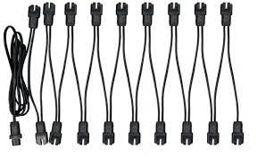
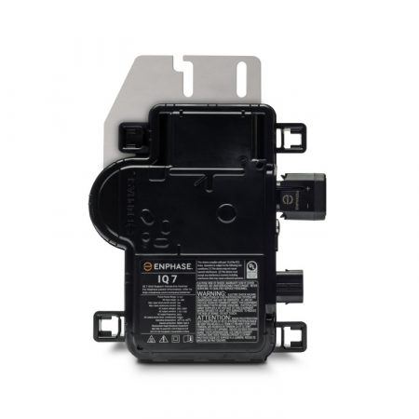
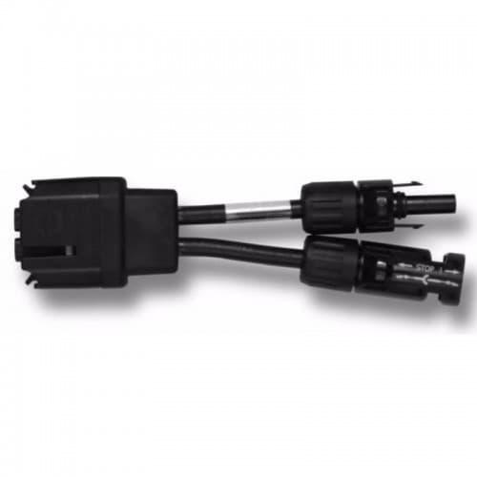
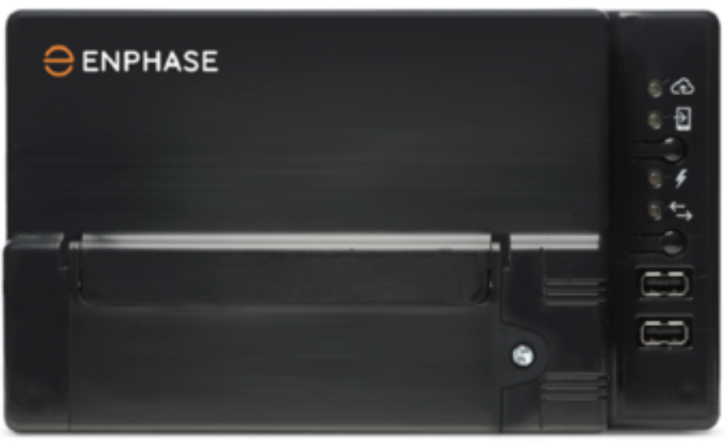
Enphase IQ Series Wiring
Key:
Red=DC
Black=AC
Array Design
- One Inverter per module
- Circuit 20Amp max (number of inverters based on inverter FLA)
- Circuits can be combined in Sub panel or Enphase combiner box. Choose carefully based on how many cells your panels are made of!
Junction Box
Disconnect
Optional
Breaker Panel
Envoy (Provides module level knowledge)

Slide 19
Enphase Array Details
One Inverter per module
Inverters strung together into circuits (15 or 20 Amp max)
Number of inverters based on inverter full load amps (FLA)
Circuits can be combined in Sub-panel or Enphase combiner box (roof)
Exterior disconnect required for each circuit into Breaker Panel
Micro inverters do MPPT and provide module level data (with optional Envoy)
IQ-8 generation provides solar only backup (with other components installed)
AC coupled batteries can be added

Slide 20
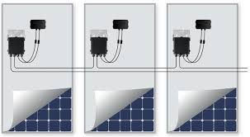
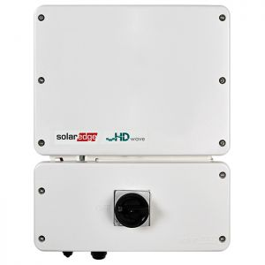
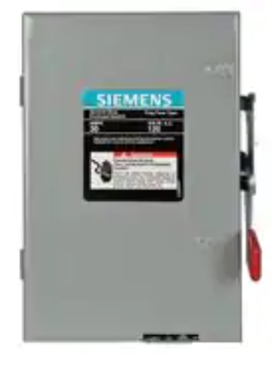
Solar Edge Wiring
Key:
Red=DC
Black=AC
Junction Box
Disconnect
System shown with optimizers
Breaker Panel
Inverter
Disconnect Required if inverter is not installed outside

Slide 21
Solar Edge Array Details
One Inverter per Array, up to 150% Inverter Max Input (will clip)
Optimizers are optional but reduce the effects of module level output variations and partial shading. They do provide NEC 2017 Module Level Rapid Shutdown
Optimizers reduce the string voltages by loading the module (optimizing power)
String length (number of modules in series) varies by inverter
Multiple strings can be combined (on roof or at inverter)
DC wire in a house MUST be inside metal conduit
Solar Edge offers a EV charger inverter combo
Solar Edge has a DC coupled battery option

Slide 22
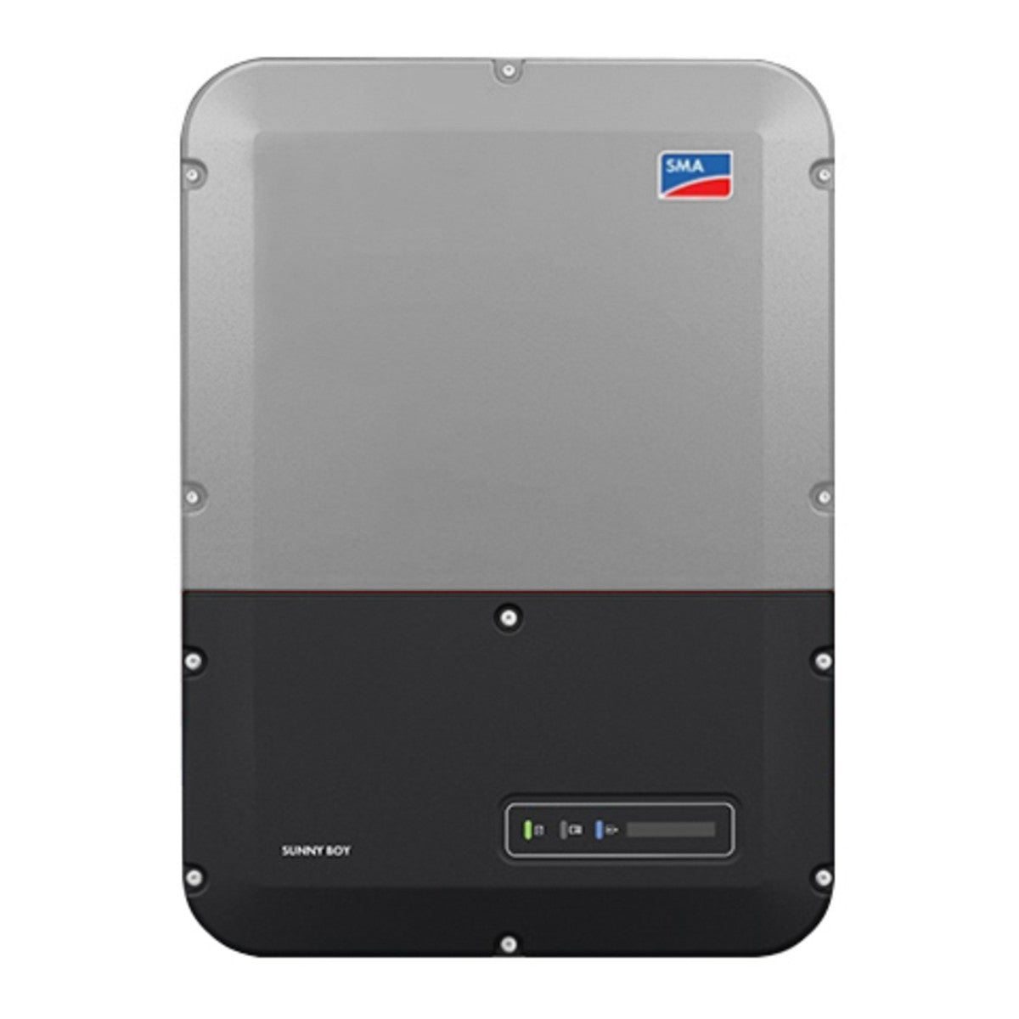
SMA Wiring
Key:
Red=DC
Black=AC
Junction Box
Disconnect
System shown with optimizers
Breaker Panel
Inverter
Disconnect Required if inverter is not installed outside

Slide 23
SMA Array Details
One Inverter per Array, up to 150% Inverter Max Input (will clip)
Optimizers are optional but reduce the effects of module level output variations and partial shading. They do provide NEC 2017 Module Level Rapid Shutdown
Optimizers reduce the string voltages by loading the module (optimizing power)
String length (number of modules in series) varies by inverter
Multiple strings can be combined (on roof or at inverter)
DC wire in a house MUST be inside metal conduit
SMA has a DC coupled battery option
SMA makes an inverter (Sunny Boy) that has a separate output for solar only backup (~1500W max)

Slide 24
What’s involved in putting it together?
Plan system
Apply for net meter (See links)
Get electrical permit (As a home owner, you can do electrical work except anything requiring a utility disconnection/ reconnection)
Get building permit (Beware, if you have trusses you will need a structural analysis)
Order parts
Install system
Get electrical inspection
Get net meter
Go live!

Slide 25
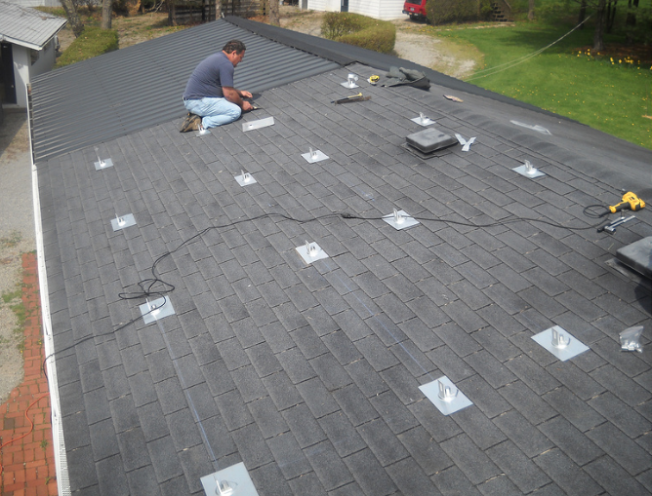
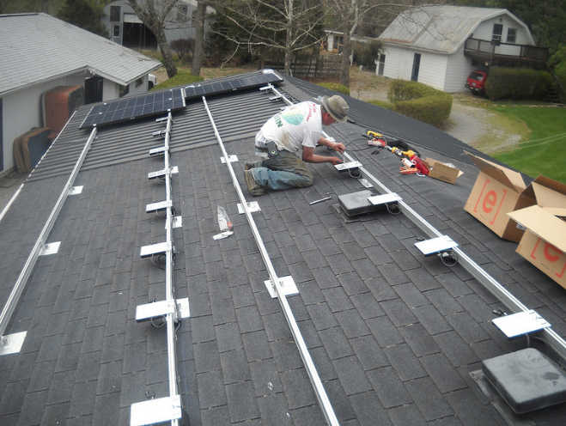

Slide 26
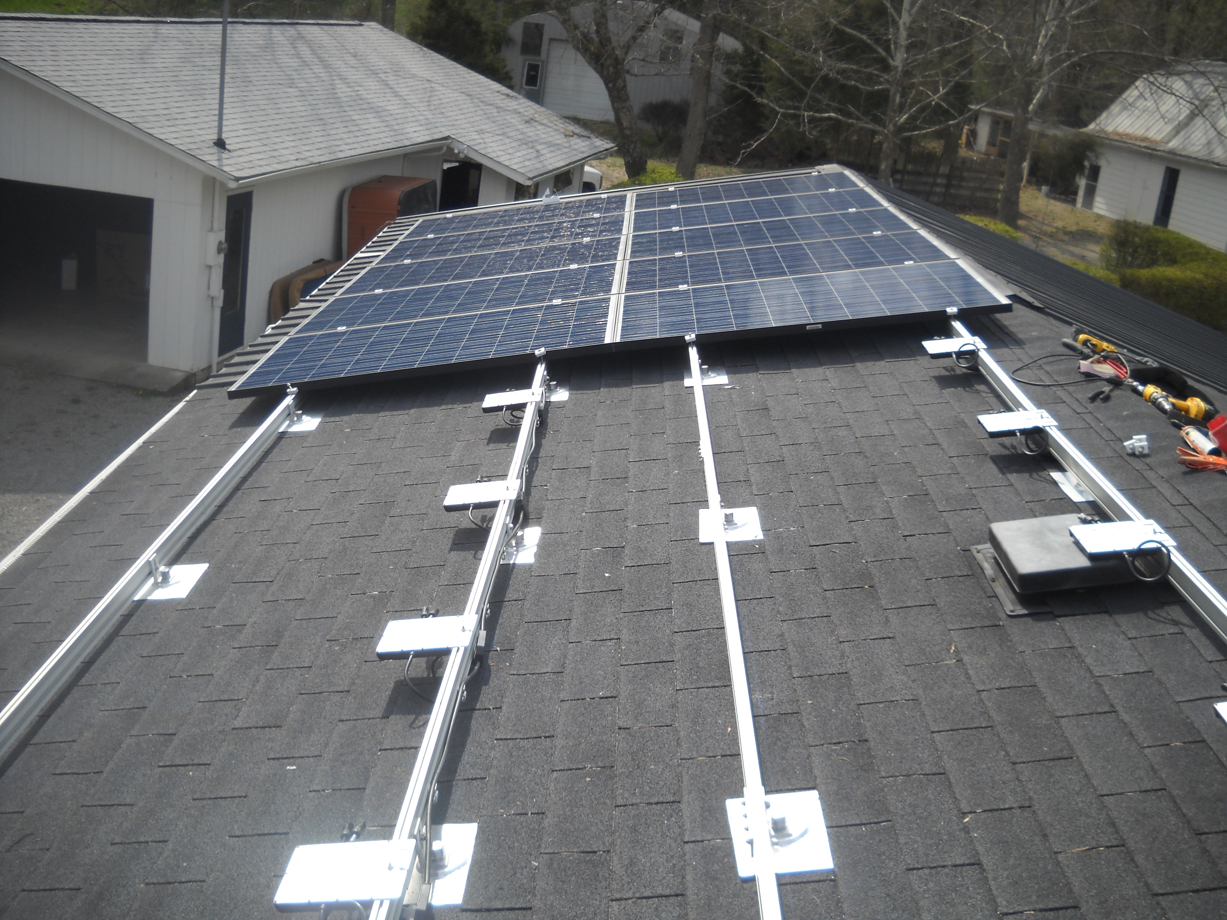
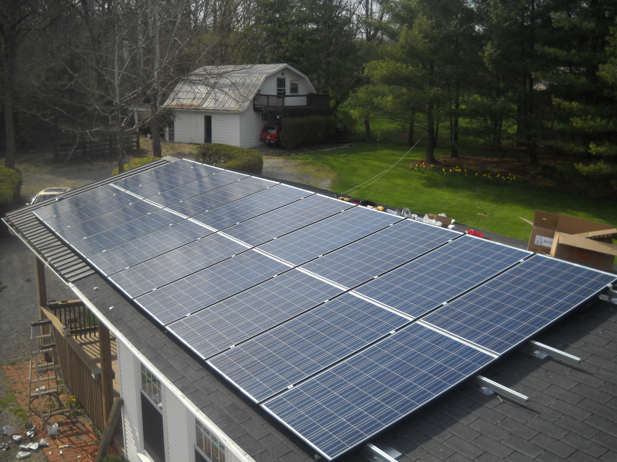

Slide 27
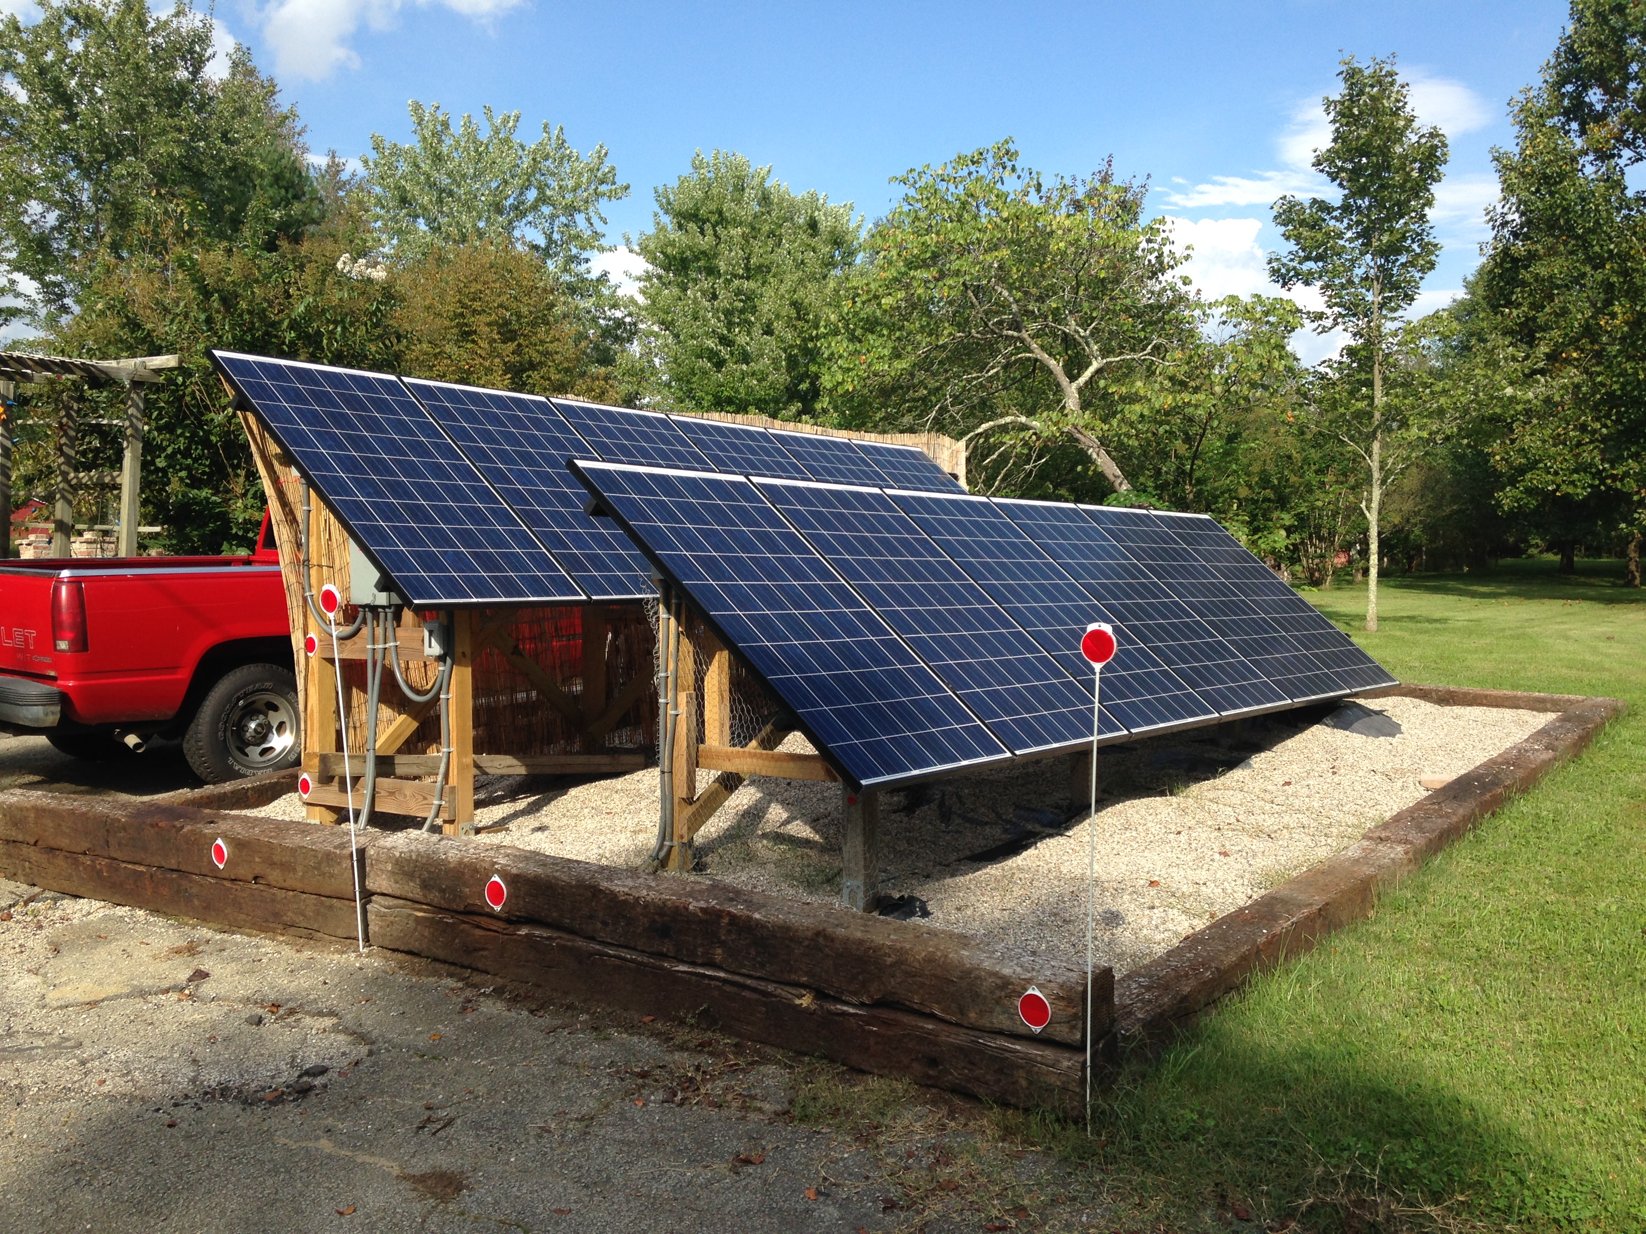
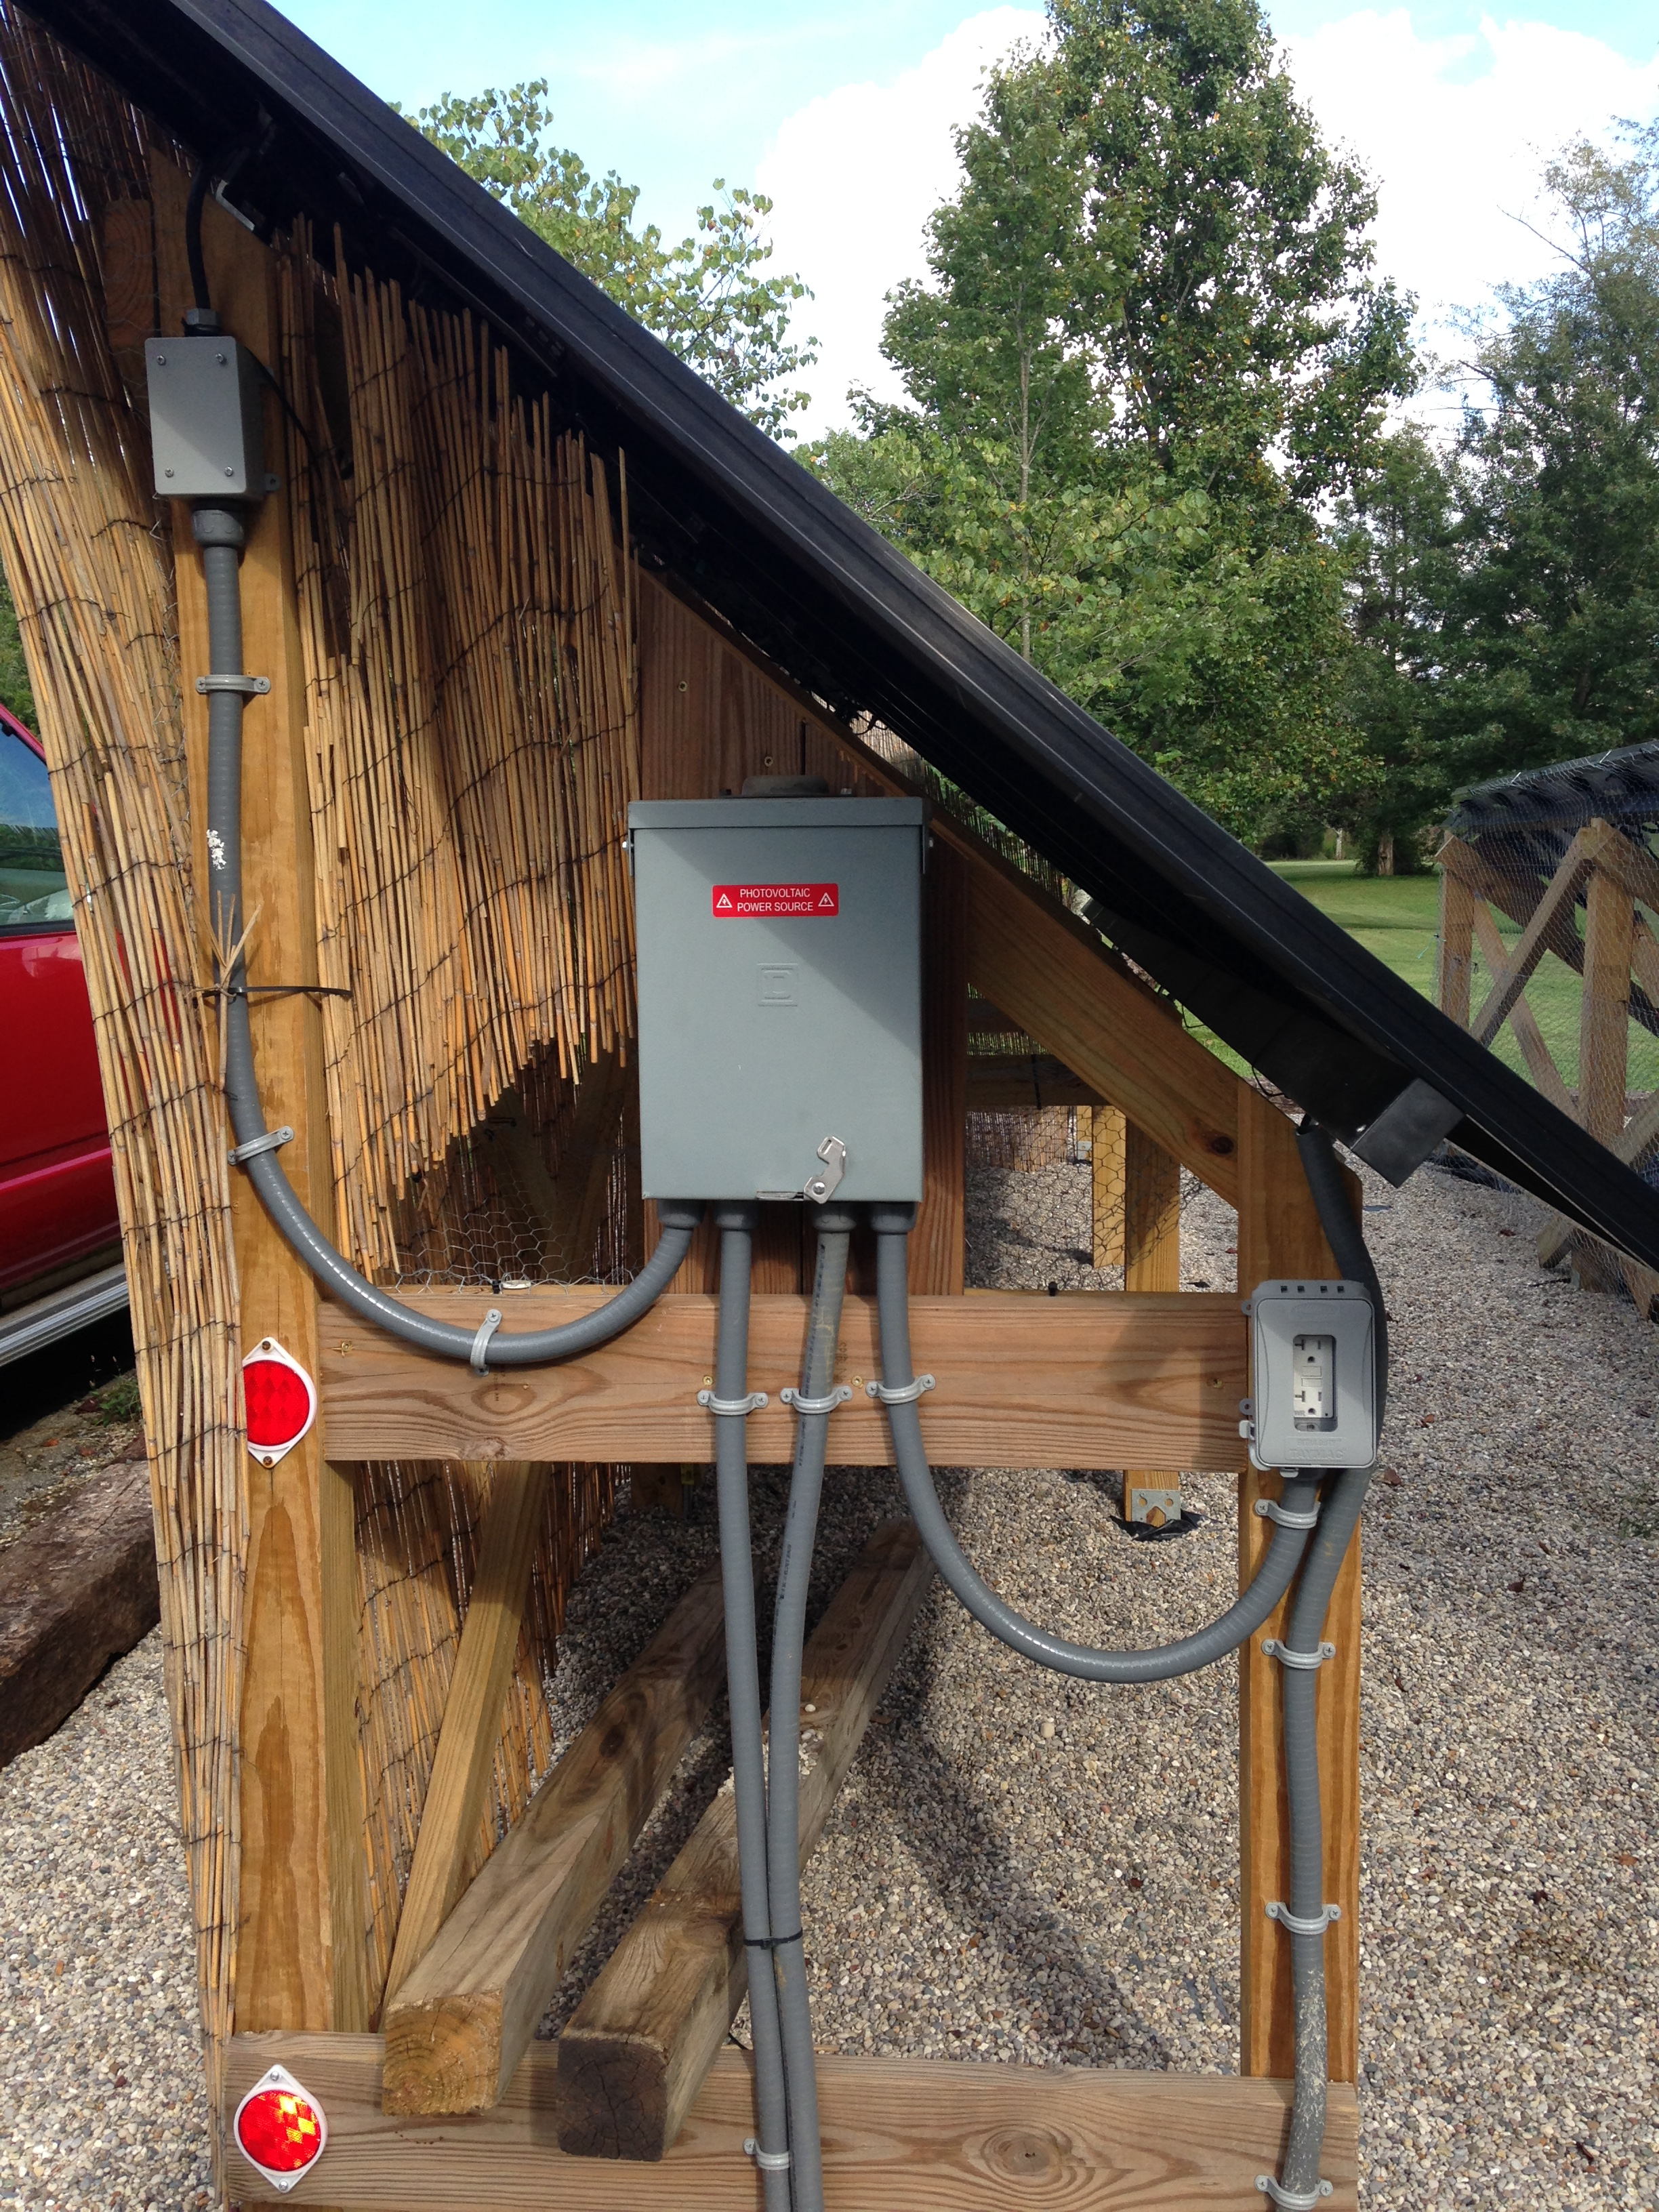

Slide 28
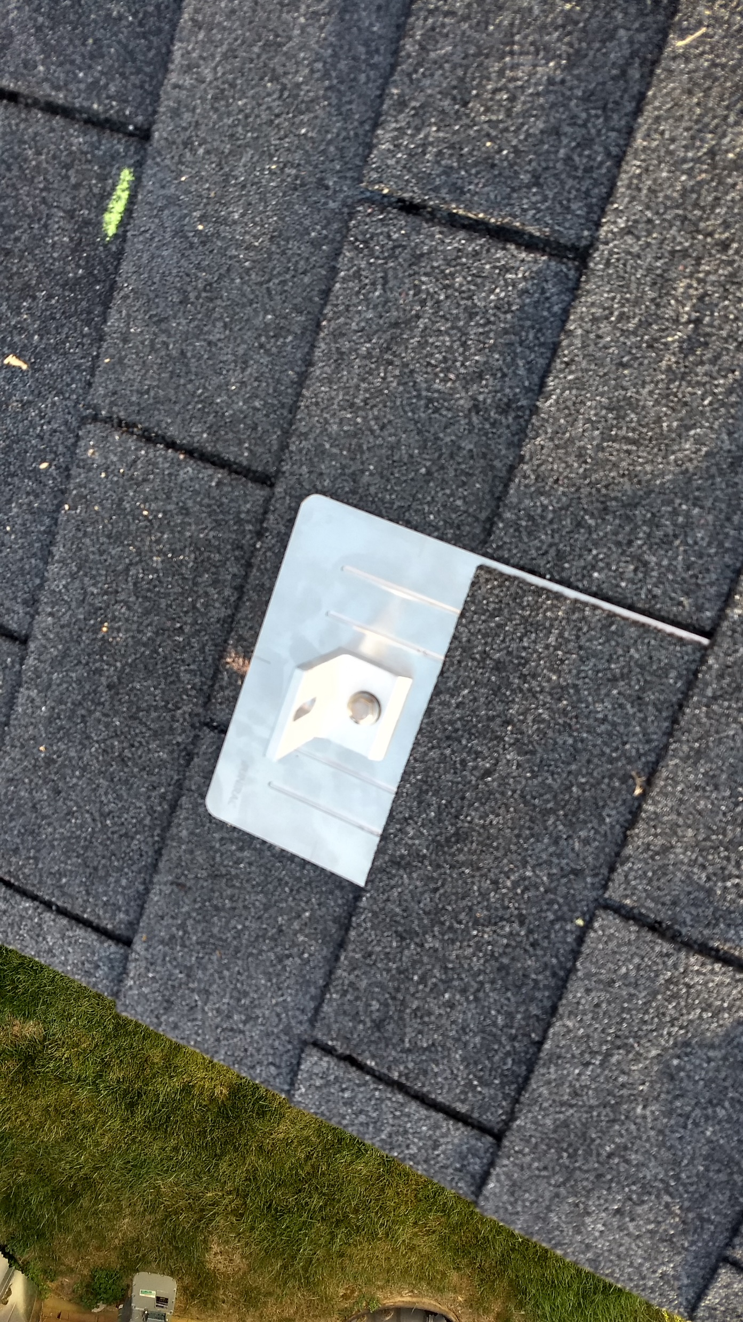
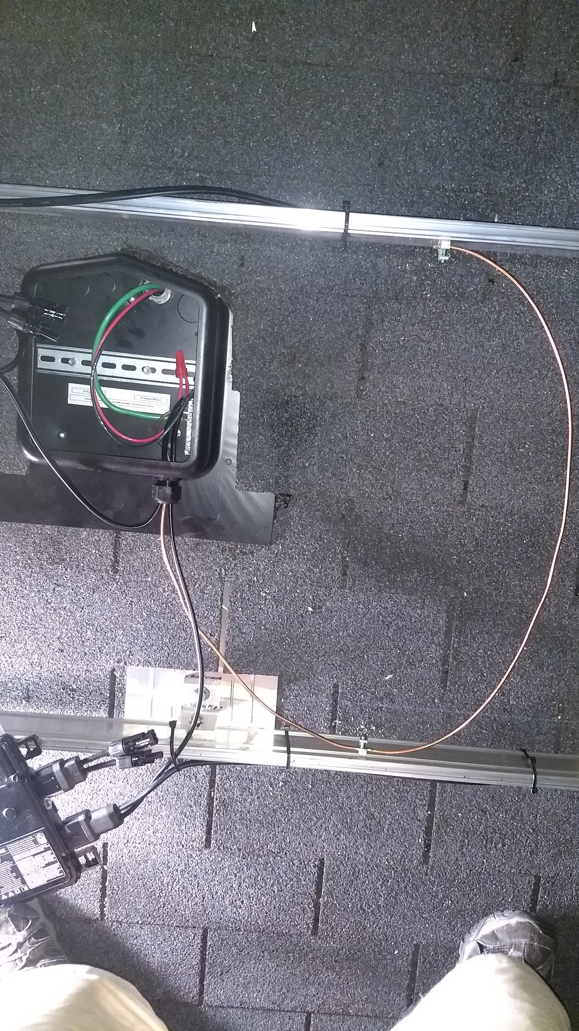
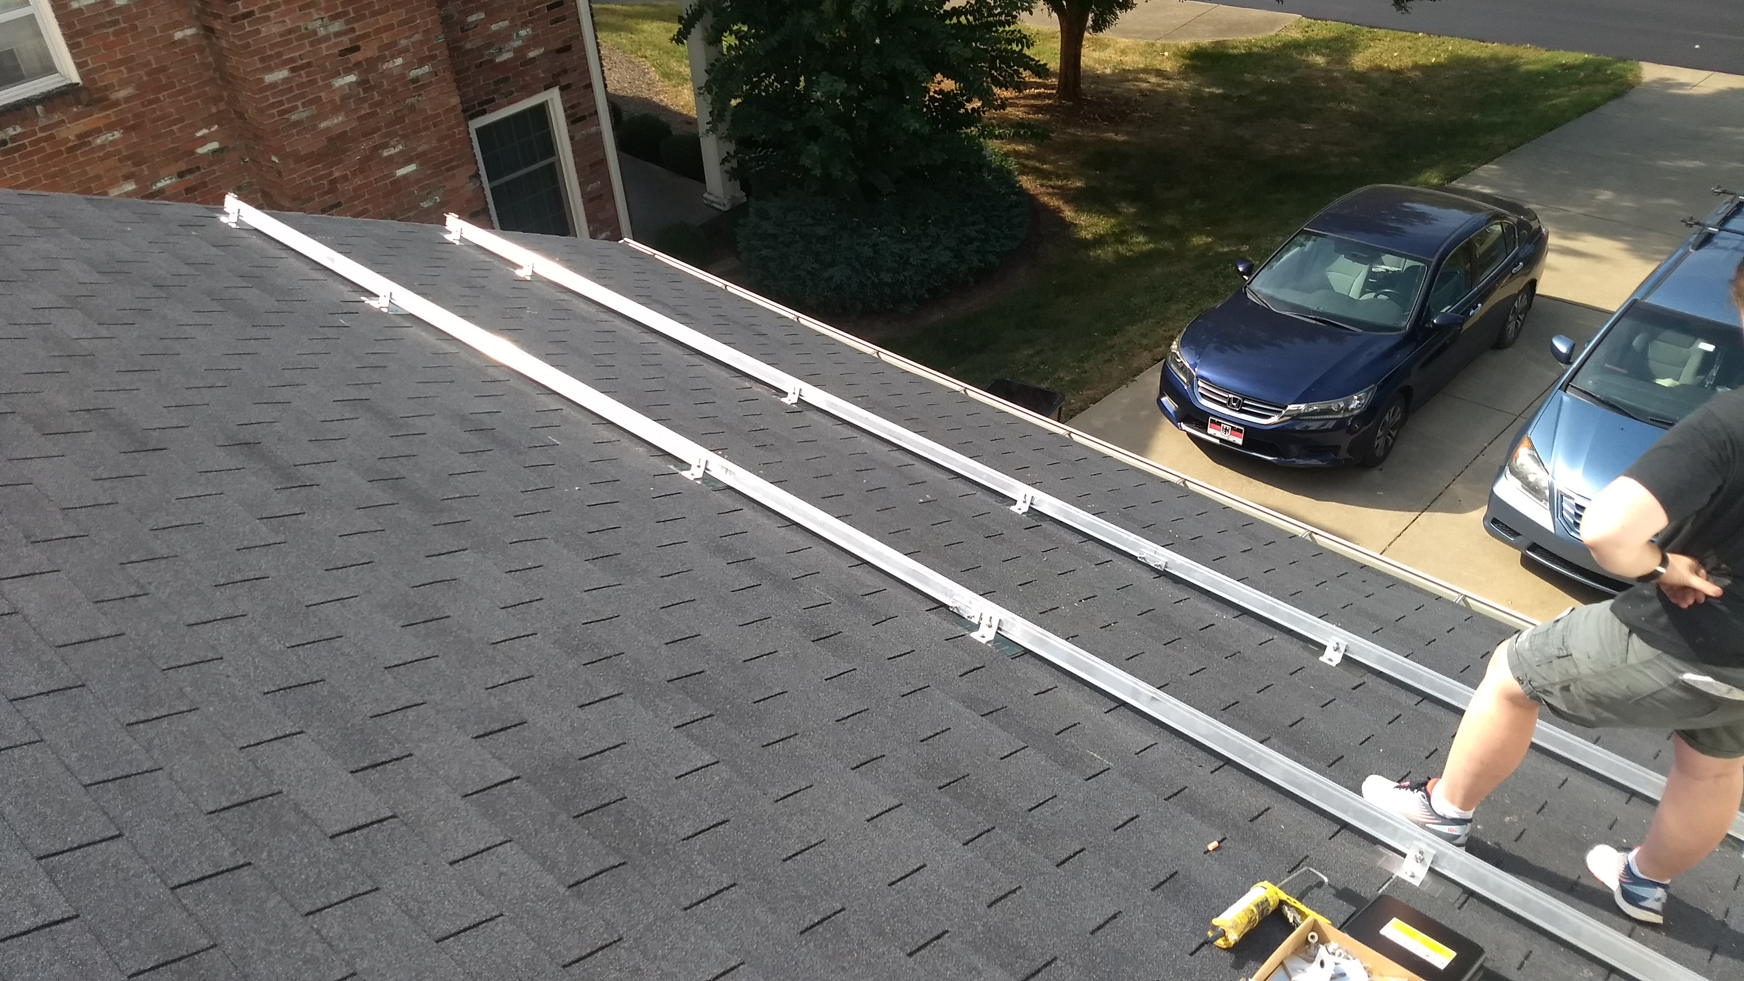

Slide 29
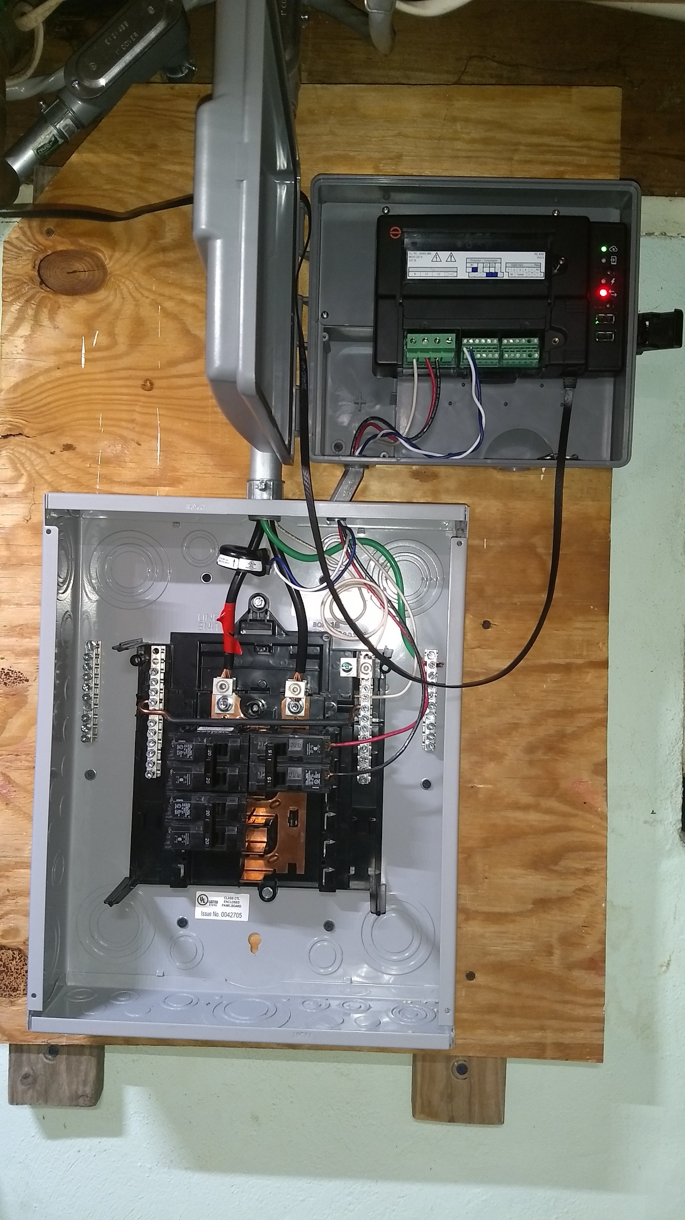
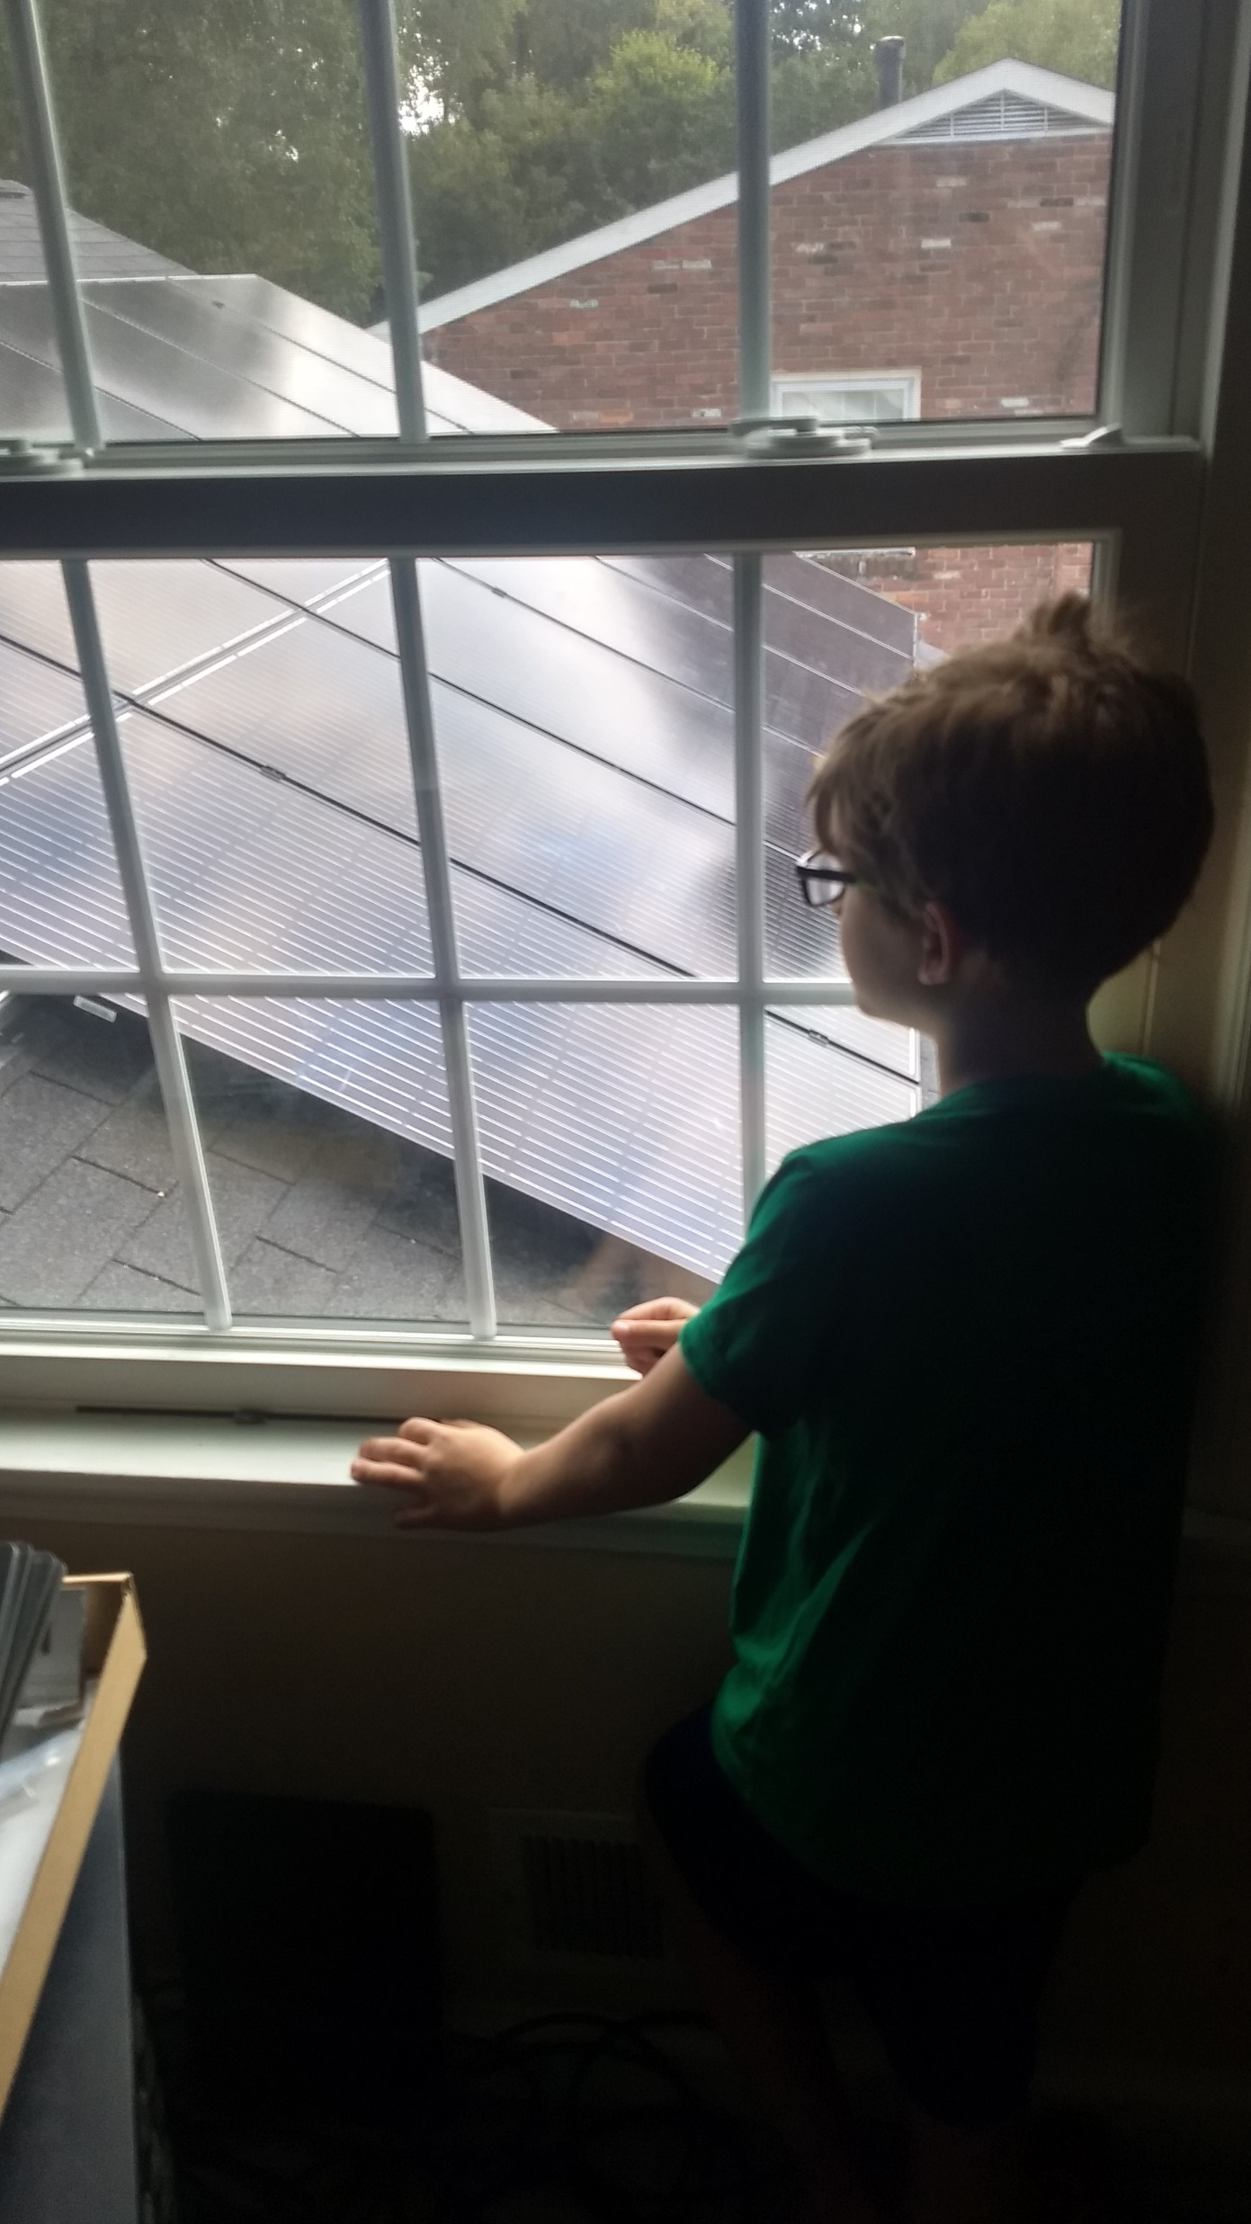
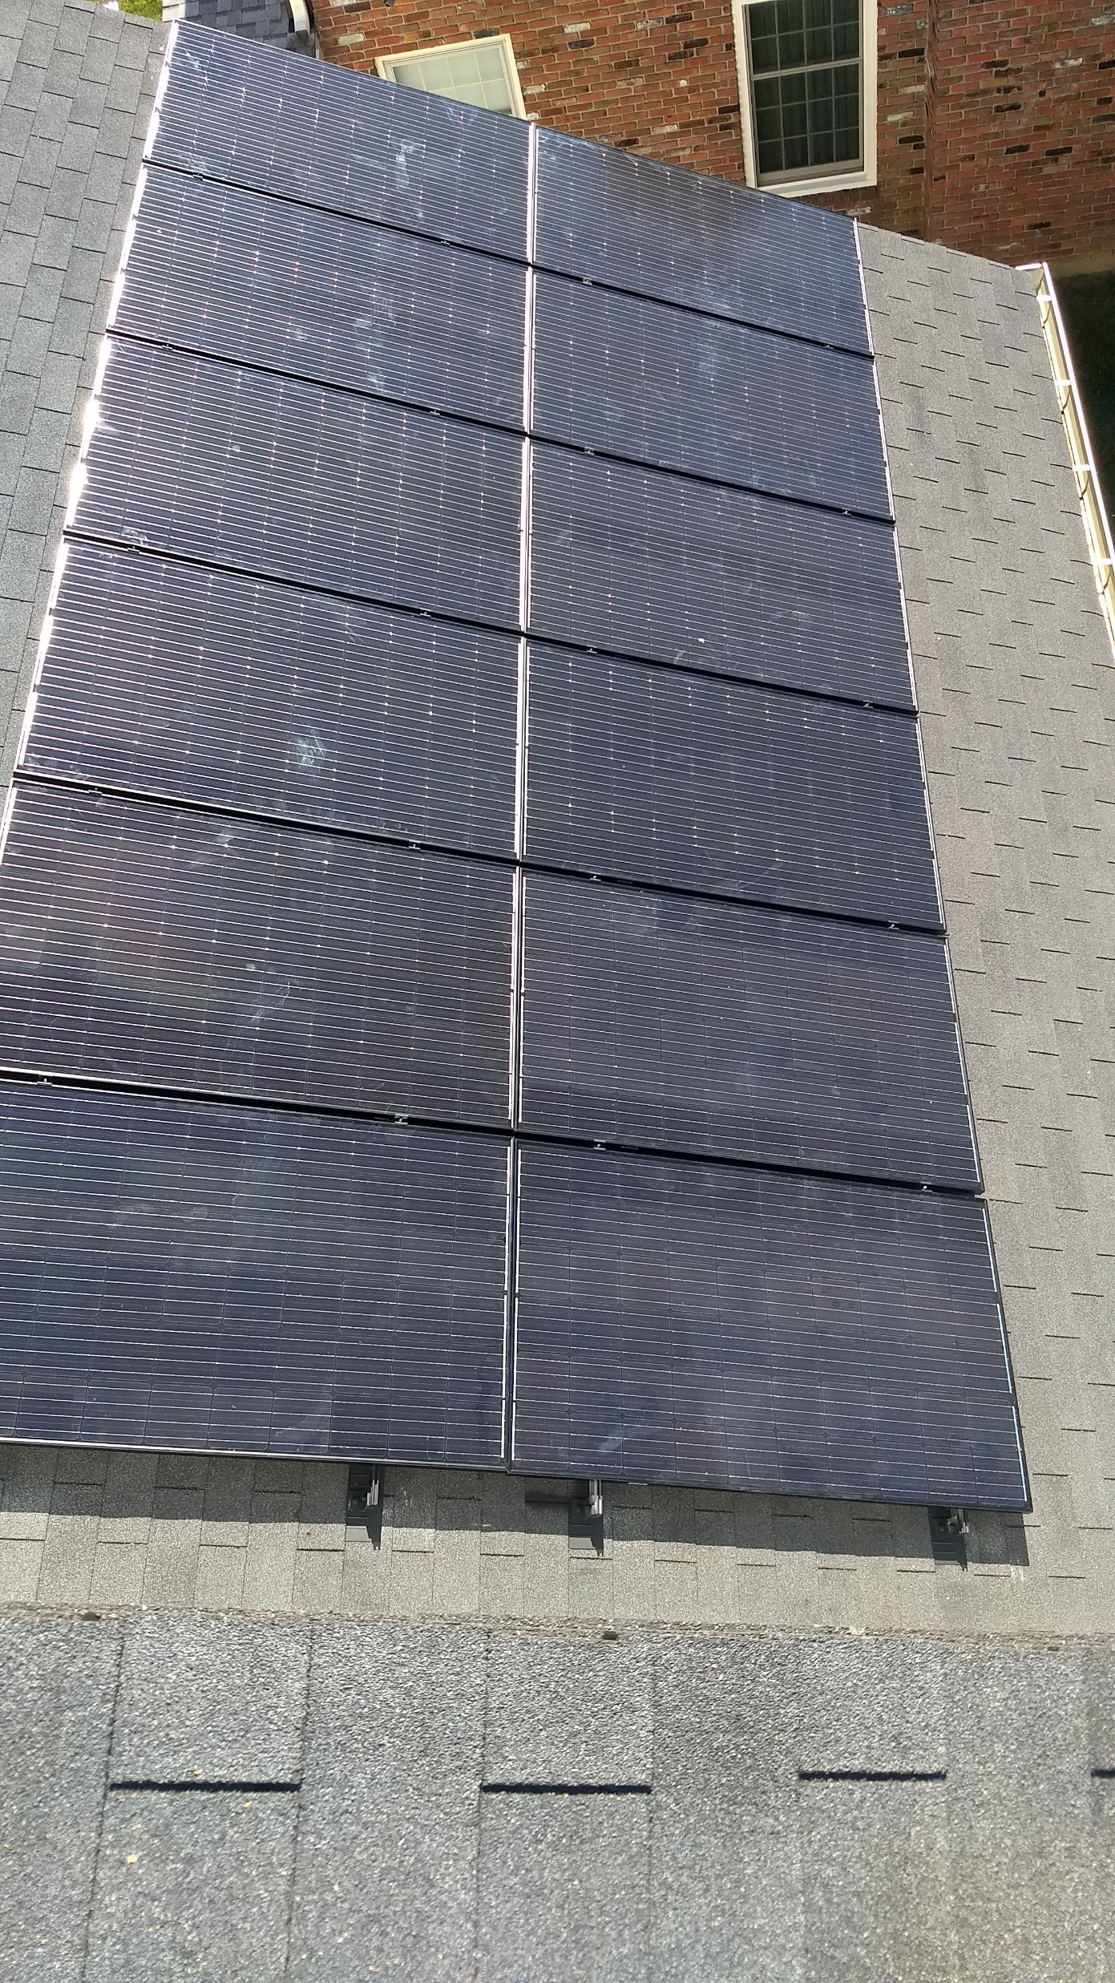

Slide 30
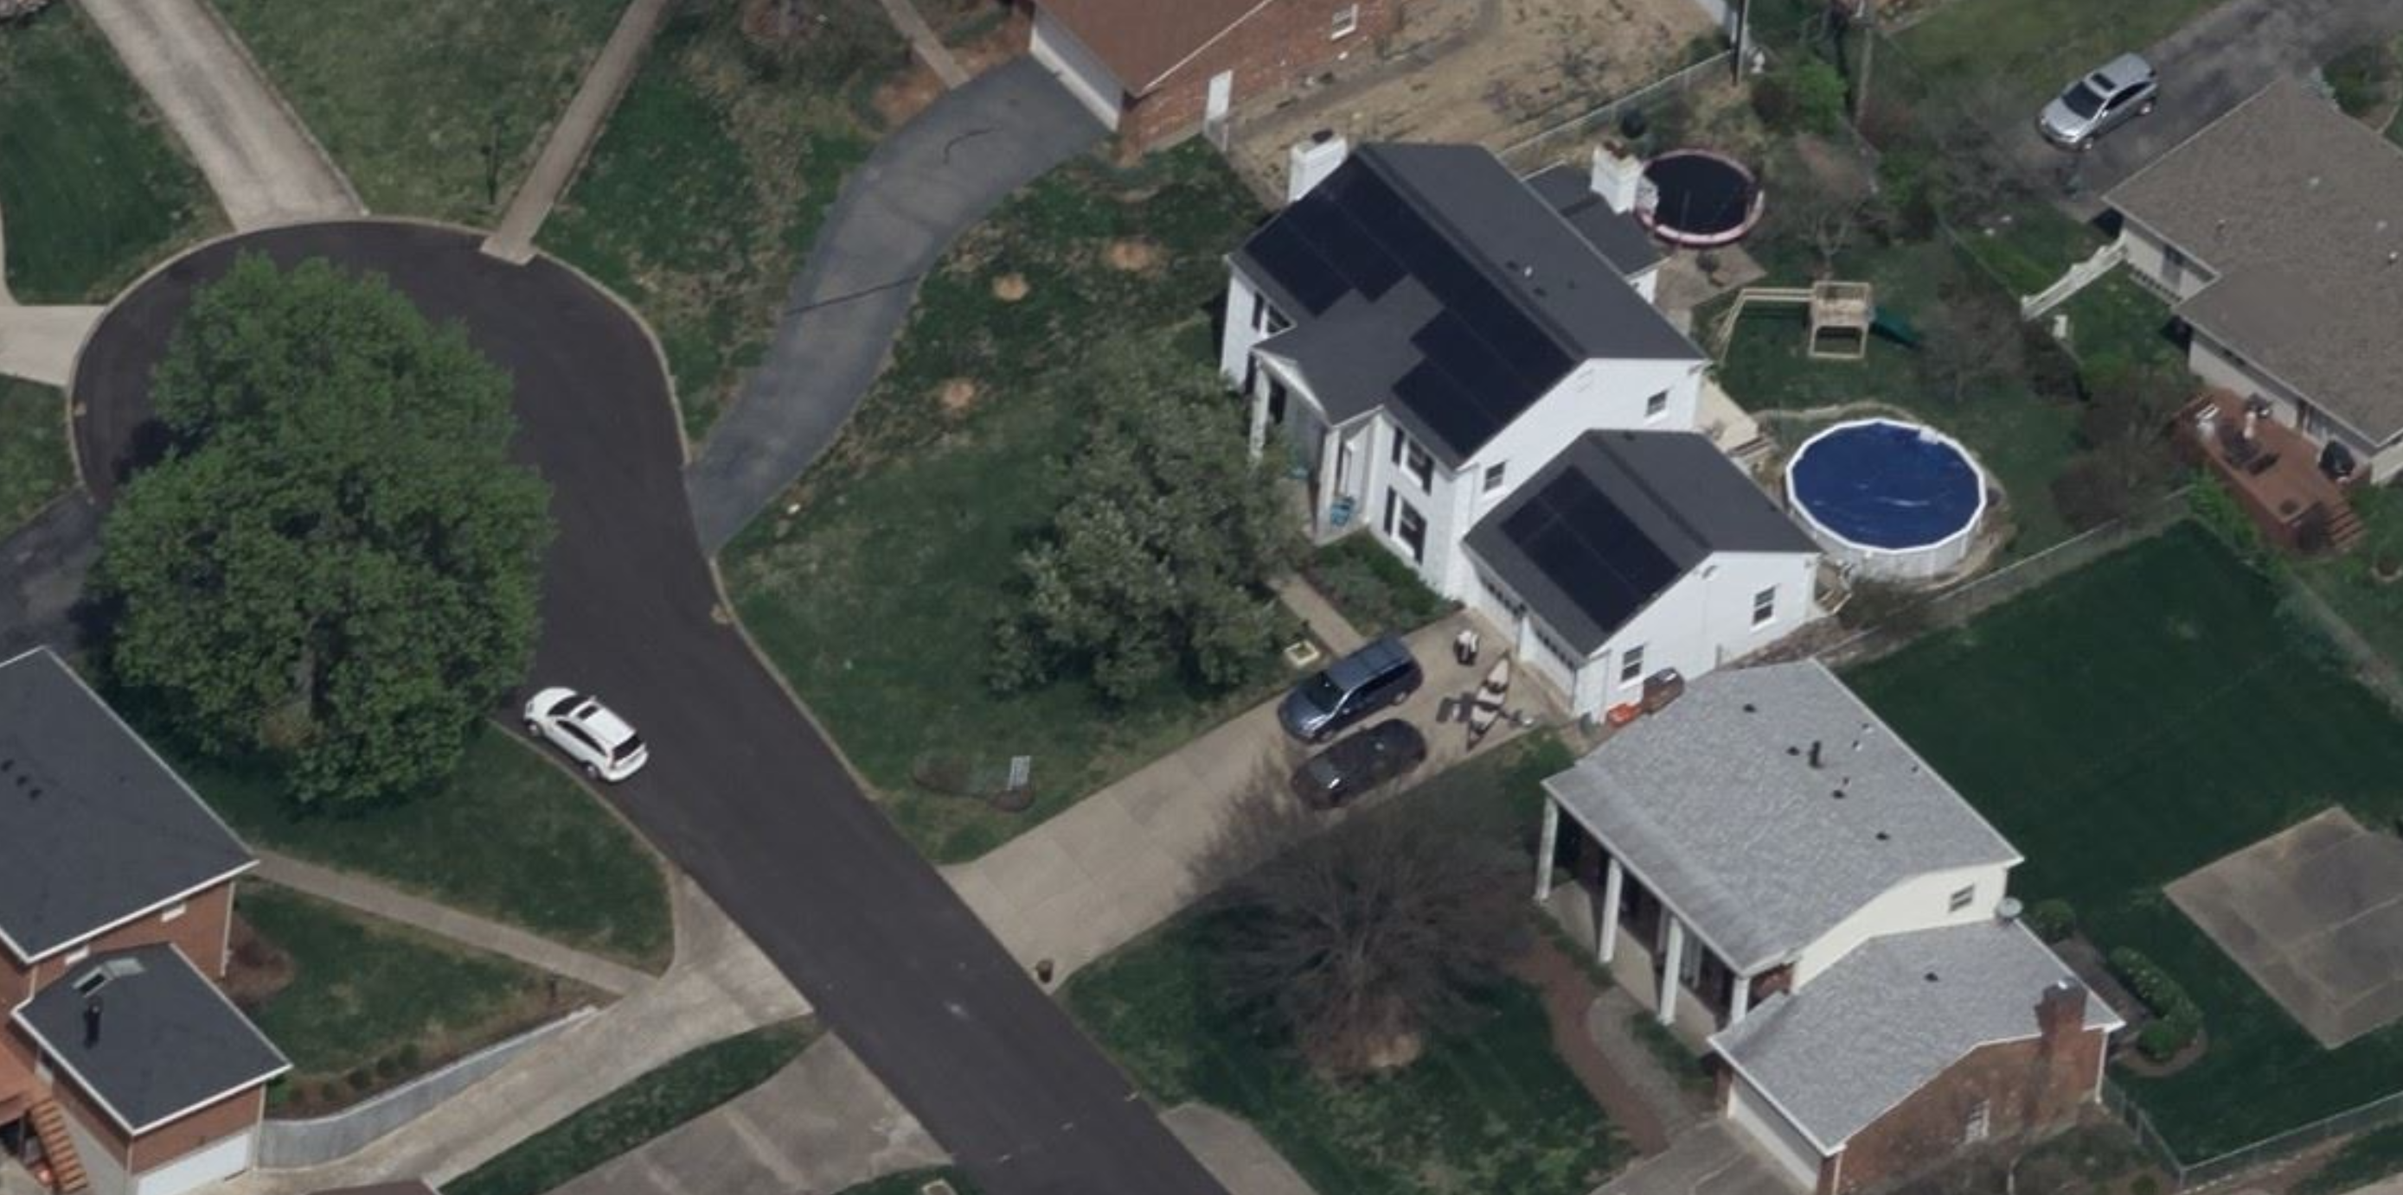

Slide 31
Suppliers
https://www.solarblvd.com/about-us/ low cost panels
https://www.wholesalesolar.com/ low cost parts
https://santansolar.com/ used solar components
https://www.invertersupply.com/ low cost racking and inverters
http://www.dudadiesel.com/solar.php solar hot water systems
And of course https://www.ebay.com/
And my personal favorite: https://louisville.craigslist.org/

Slide 32
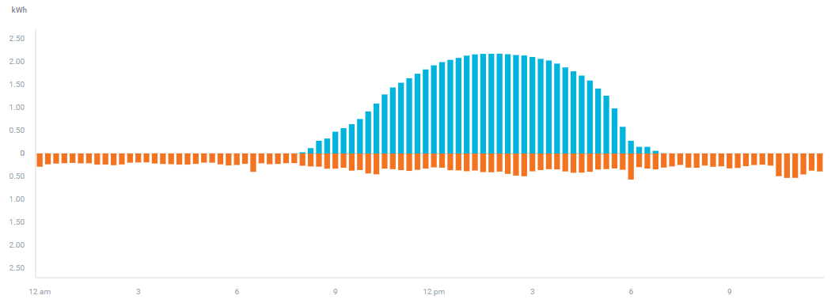
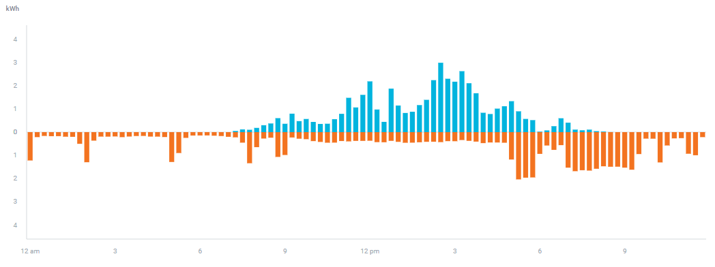
Your Mileage May Vary
9/5/20 -27.4 kwh imported
57.0 kwh exported
Net 29.6 kWh
Wholesale/ Retail is heavily dependent on when you use your power.
Good day to do laundry, the dishes, etc.
As batteries come down in cost, it will be viable to store this exported amount and use it later
8/1/20 -40.1 kwh imported
27.3 kwh exported
Net -12.8 kWh
Shift load to here

Slide 33
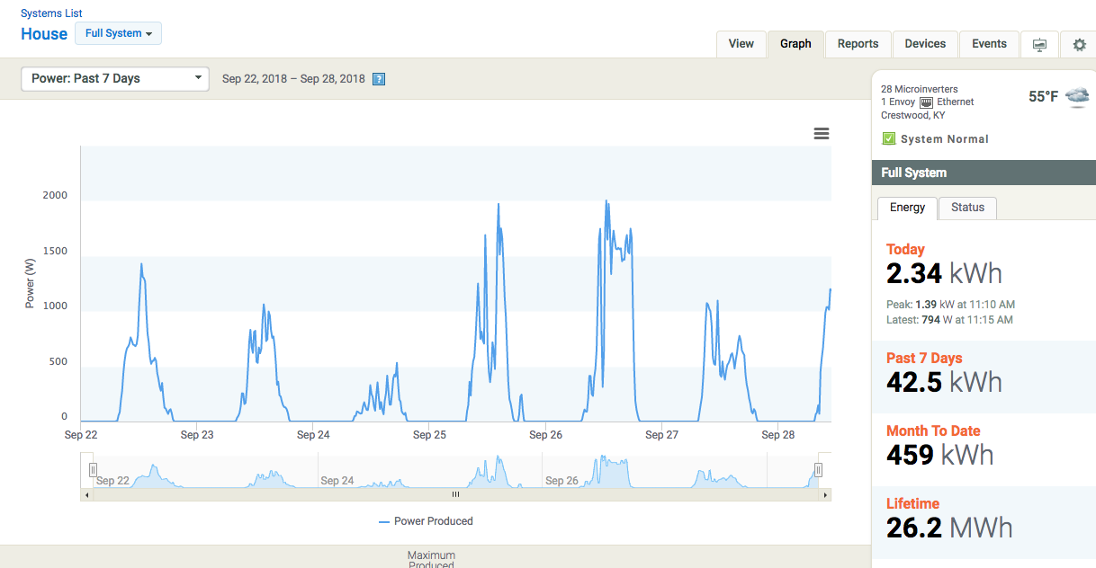
Toys – Enphase enlighten

Slide 34
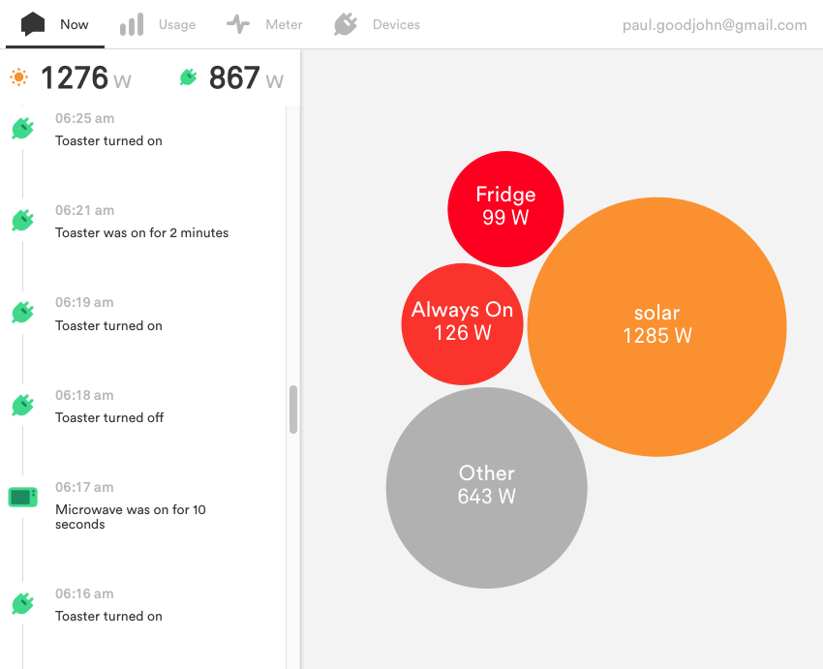
Toys - sense

Slide 35
LG&E/KU rates
The current prices for new net meter customers is as follows:
LG&E:
Power you make and sell to them: $0.06924/kwh.
Power you use from them: $0.10082
Likewise with KU - they buy at $0.07366

Slide 36
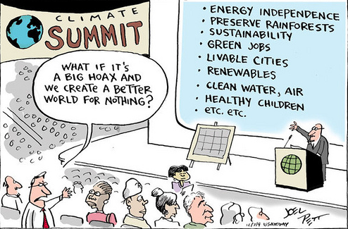
Questions?

